Slide 1
Analyzing geospatial data in R
R/Medicine Conference Workshop
August 24, 2022
Sherrie Xie, VMD, PhD

Slide 2
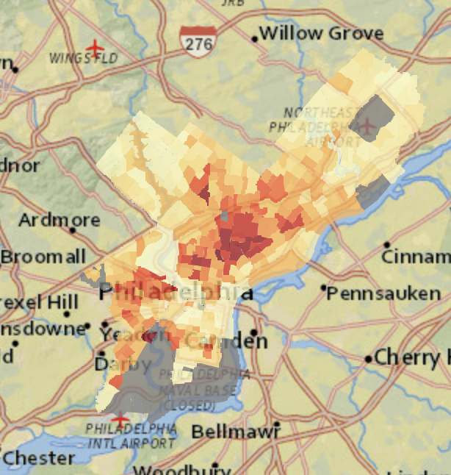
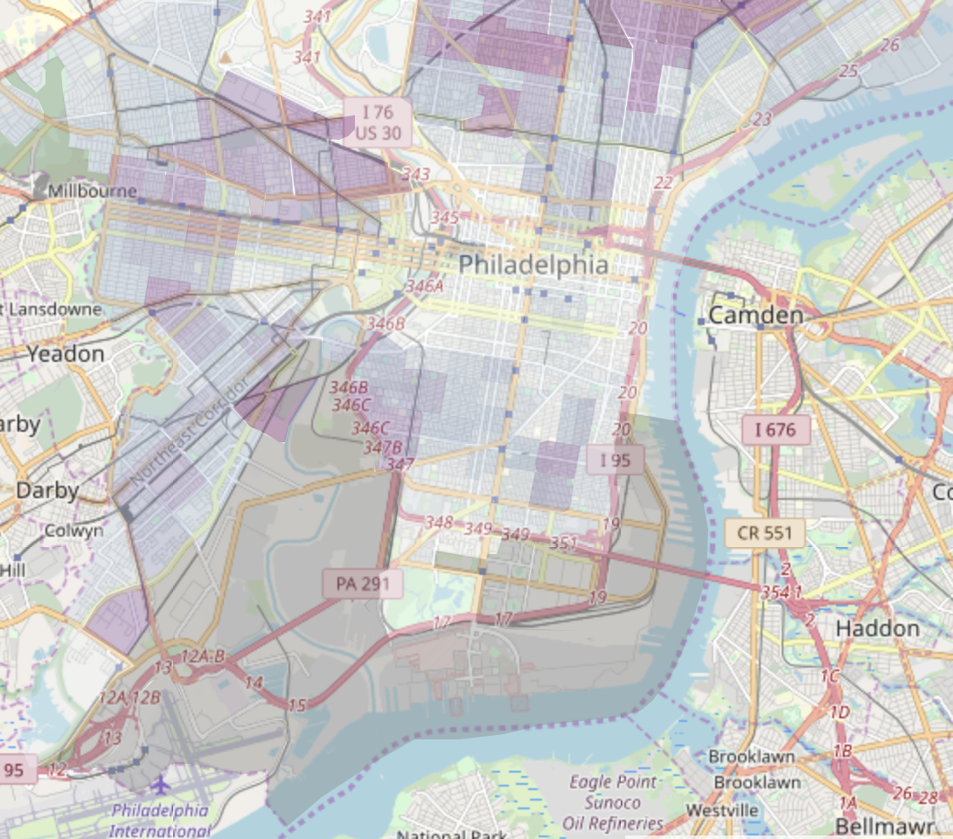
Workshop overview
Spatial data in R
Spatial data types – points, lines, polygons, and rasters
Brief introduction to analysis of spatial health data
–– BREAK #1 ––
Case example: Lyme disease in New York State
Global clustering analysis (Moran’s I)
–– BREAK #2 ––
Local clustering analysis (LISA – local Moran’s I)

Slide 3
R for spatial data analysis
Wide capabilities and many packages
sp framework has formed the backbone of R GIS tools for over a decade
sf framework (much more user-friendly!) introduced several years and gradually replacing sp
Advantages of performing geospatial analysis in R
Statistical computing capabilities and impressive graphics engine makes it adept for spatial analysis and mapping
Command-line interface enables analysis and visualization to be customizable, transparent, and reproducible

Slide 4
Geospatial data types
Vector data
Points
Lines
Polygons
Raster data
Data stored in a regular grid of cells, e.g. elevation and satellite images
(x₃, y₃)
(x₁, y₁)
(x₂, y₂)

Slide 5
Geospatial data types
Vector data
Points
Lines
Polygons
Raster data
Data stored in a regular grid of cells, e.g. elevation and satellite images
(x₃, y₃)
(x₁, y₁)
(x₂, y₂)

Slide 6
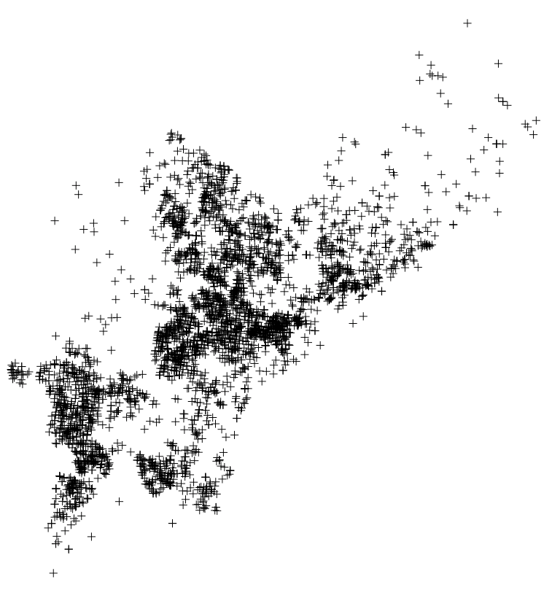
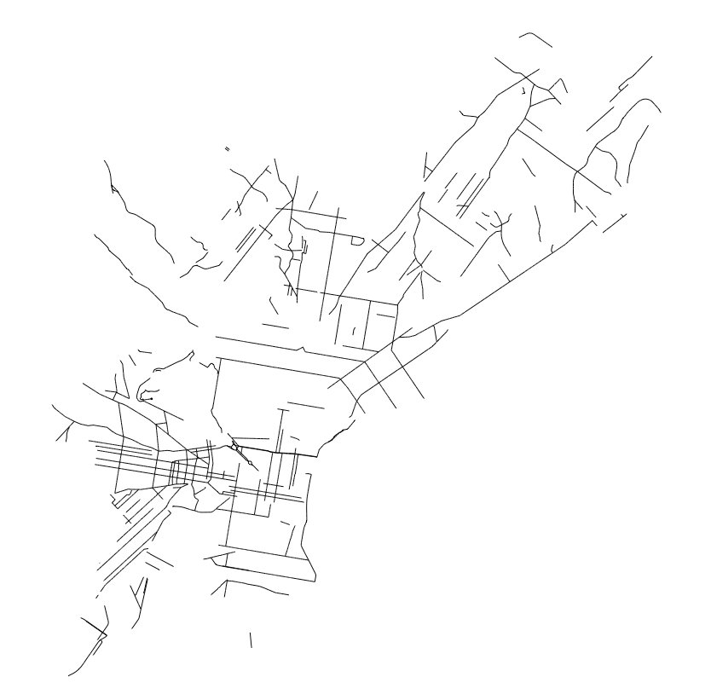
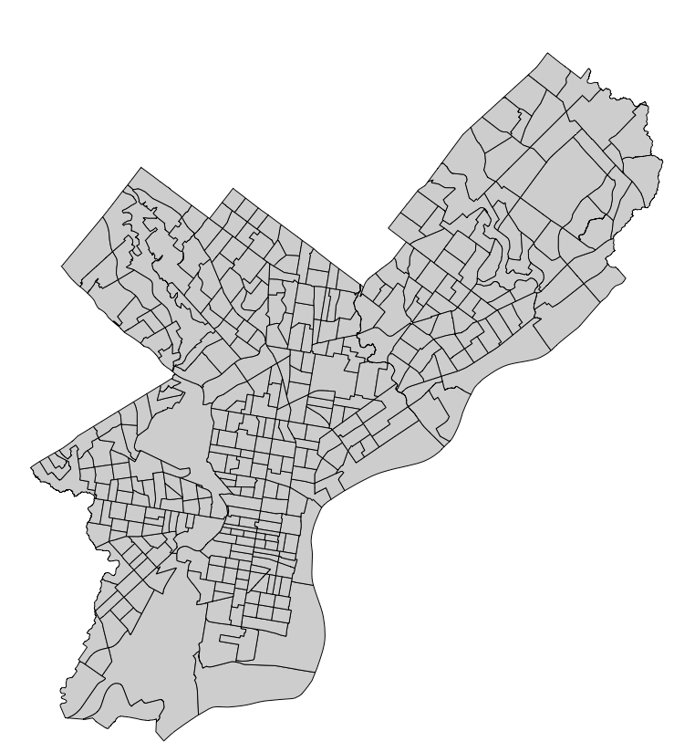
Vector data examples
Locations of Shootings, 2017
Philadelphia Police Department Crime Incidents Database
Bike-Accessible Roads
Philadlephia Bike Network Dataset, OpenDataPhilly
Census Tracts, 2010
U.S. Census Bureau
POINTS
LINES
POLYGONS

Slide 7
GIS data types
Vector data
Points
Lines
Polygons
Raster data
Data stored in a regular grid of cells, e.g. elevation and satellite images
(x₃, y₃)
(x₁, y₁)
(x₂, y₂)

Slide 8
GIS data types
Vector data
Points
Lines
Polygons
Raster data
Data stored in a regular grid of cells, e.g. elevation and satellite images
(x₃, y₃)
(x₁, y₁)
(x₂, y₂)
Notes:
Let’s take a look at some examples of

Slide 9
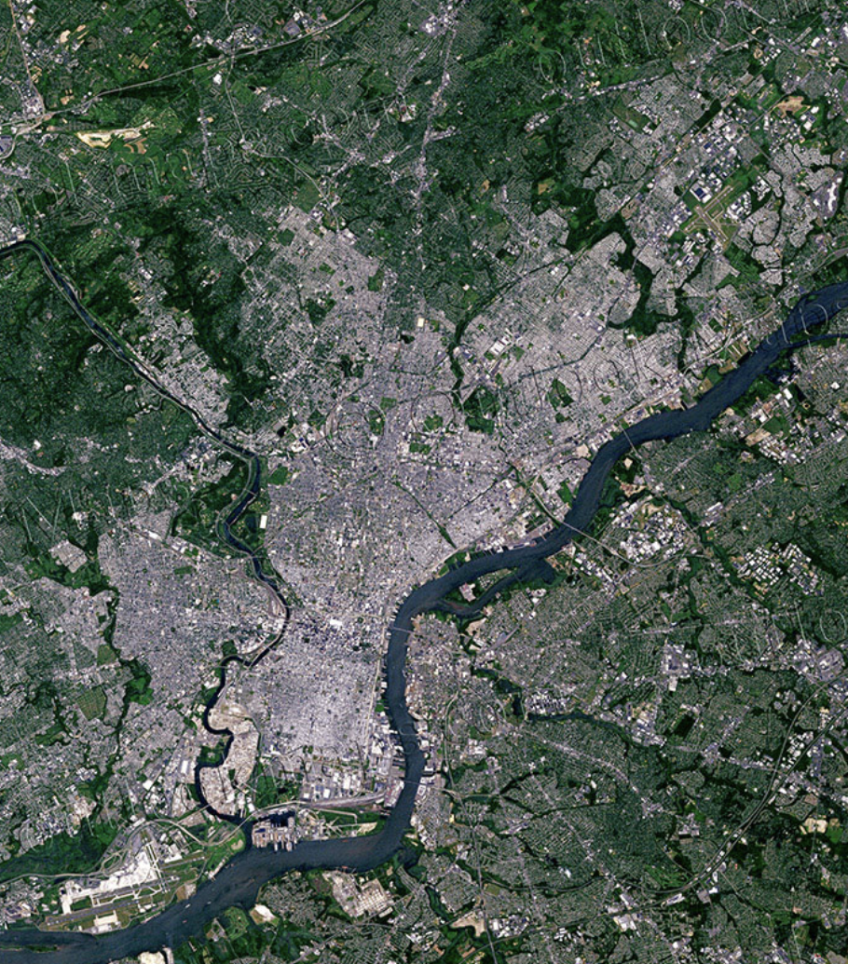
Raster examples
Satellite image of Philadelphia
Land cover classification for Philadelphia
Google Earth, 2018
USDA Forest Service and University of Vermont Spatial Analysis Laboratory, 2011

Slide 10

R spatial data classes
 |  |  | sp framework |  |  | sf framework
GIS data type |  |  |  | Class |  | Class | Geometry type
 | Points |  |  | SpatialPointsDataFrame |  | sf | MULTIPOINT
 | Lines |  |  | SpatialLinesDataFrame |  | sf | MULTILINESTRING
 | Polygons |  |  | SpatialPolygonsDataFrame |  | sf | MULTIPOLYGON
 | Raster |  |  | SpatialPixelsDataFrame
*sf can only handle vector data

Slide 11
R spatial data classes
 |  |  | sp framework |  |  | sf framework
GIS data type |  |  |  | Class |  | Class | Geometry type
 | Points |  |  | SpatialPointsDataFrame |  | sf | MULTIPOINT
 | Lines |  |  | SpatialLinesDataFrame |  | sf | MULTILINESTRING
 | Polygons |  |  | SpatialPolygonsDataFrame |  | sf | MULTIPOLYGON
 | Raster |  |  | SpatialPixelsDataFrame
*sf can only handle vector data

Slide 12
R spatial data classes
 |  |  | sp framework |  |  | sf framework
GIS data type |  |  |  | Class |  | Class | Geometry type
 | Points |  |  | SpatialPointsDataFrame |  | sf | MULTIPOINT
 | Lines |  |  | SpatialLinesDataFrame |  | sf | MULTILINESTRING
 | Polygons |  |  | SpatialPolygonsDataFrame |  | sf | MULTIPOLYGON
 | Raster |  |  | SpatialPixelsDataFrame
*sf can only handle vector data

Slide 13
R spatial objects comprise spatial and data attributes
sp or sf object
Spatial attributes
Data attributes
Boundaries
Projection
Geocoordinates
n = 384
POL ID | Var1 | Var2 | Var3 | ...
1 | x₁ | y₁ | z₁
2 | x₂ | y₂ | z₂
3 | x₃ | y₃ | z₃
384 | x₃₈₄ | y₃₈₄ | z₃₈₄
384 rows
(data.frame format)

Slide 14
R spatial objects comprise spatial and data attributes
sp or sf object
Spatial attributes
Data attributes
Boundaries
Projection
Geocoordinates
n = 384
POL ID | Var1 | Var2 | Var3 | ...
1 | x₁ | y₁ | z₁
2 | x₂ | y₂ | z₂
3 | x₃ | y₃ | z₃
384 | x₃₈₄ | y₃₈₄ | z₃₈₄
384 rows
(data.frame format)

Slide 15
R spatial objects comprise spatial and data attributes
sp or sf object
Spatial attributes
Data attributes
Boundaries
Projection
Geocoordinates
n = 384
POL ID | Var1 | Var2 | Var3 | ...
1 | x₁ | y₁ | z₁
2 | x₂ | y₂ | z₂
3 | x₃ | y₃ | z₃
384 | x₃₈₄ | y₃₈₄ | z₃₈₄
384 rows
(data.frame format)

Slide 16
Analysis of spatial health data
Broadly speaking, goal is to assess for spatial patterns of disease risk or incidence
Presence of spatial patterns may support specific etiologies or risk factors (e.g., environmental hazards or infectious processes)
Formal investigation of spatial patterns relies on spatial statistics
Spatial epidemiology involves visualizing (mapping) health data and applying spatial statistics to study geographic variations of disease

Slide 17
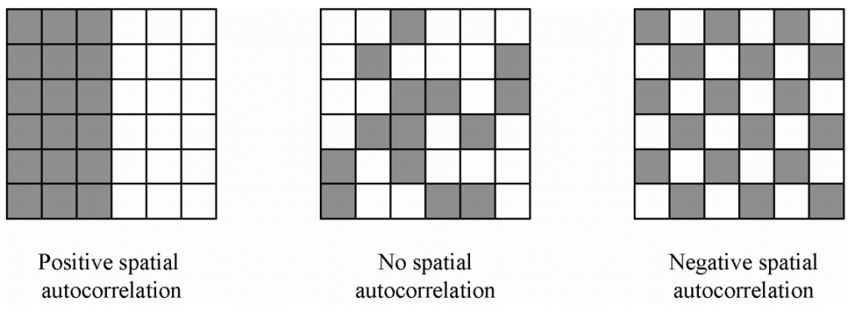
Types of spatial patterns
RANDOM
No spatial autocorrelation
NON-RANDOM
POSITIVE spatial autocorrelation
NON-RANDOM
NEGATIVE spatial autocorrelation
https://thewinnower.com/papers/2847-some-methods-for-measuring-and-correcting-for-spatial-autocorrelation

Slide 18
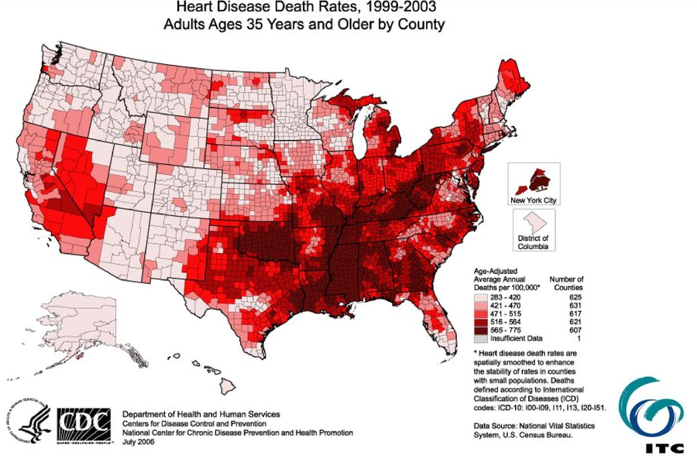
An example of positive spatial autocorrelation

Slide 19
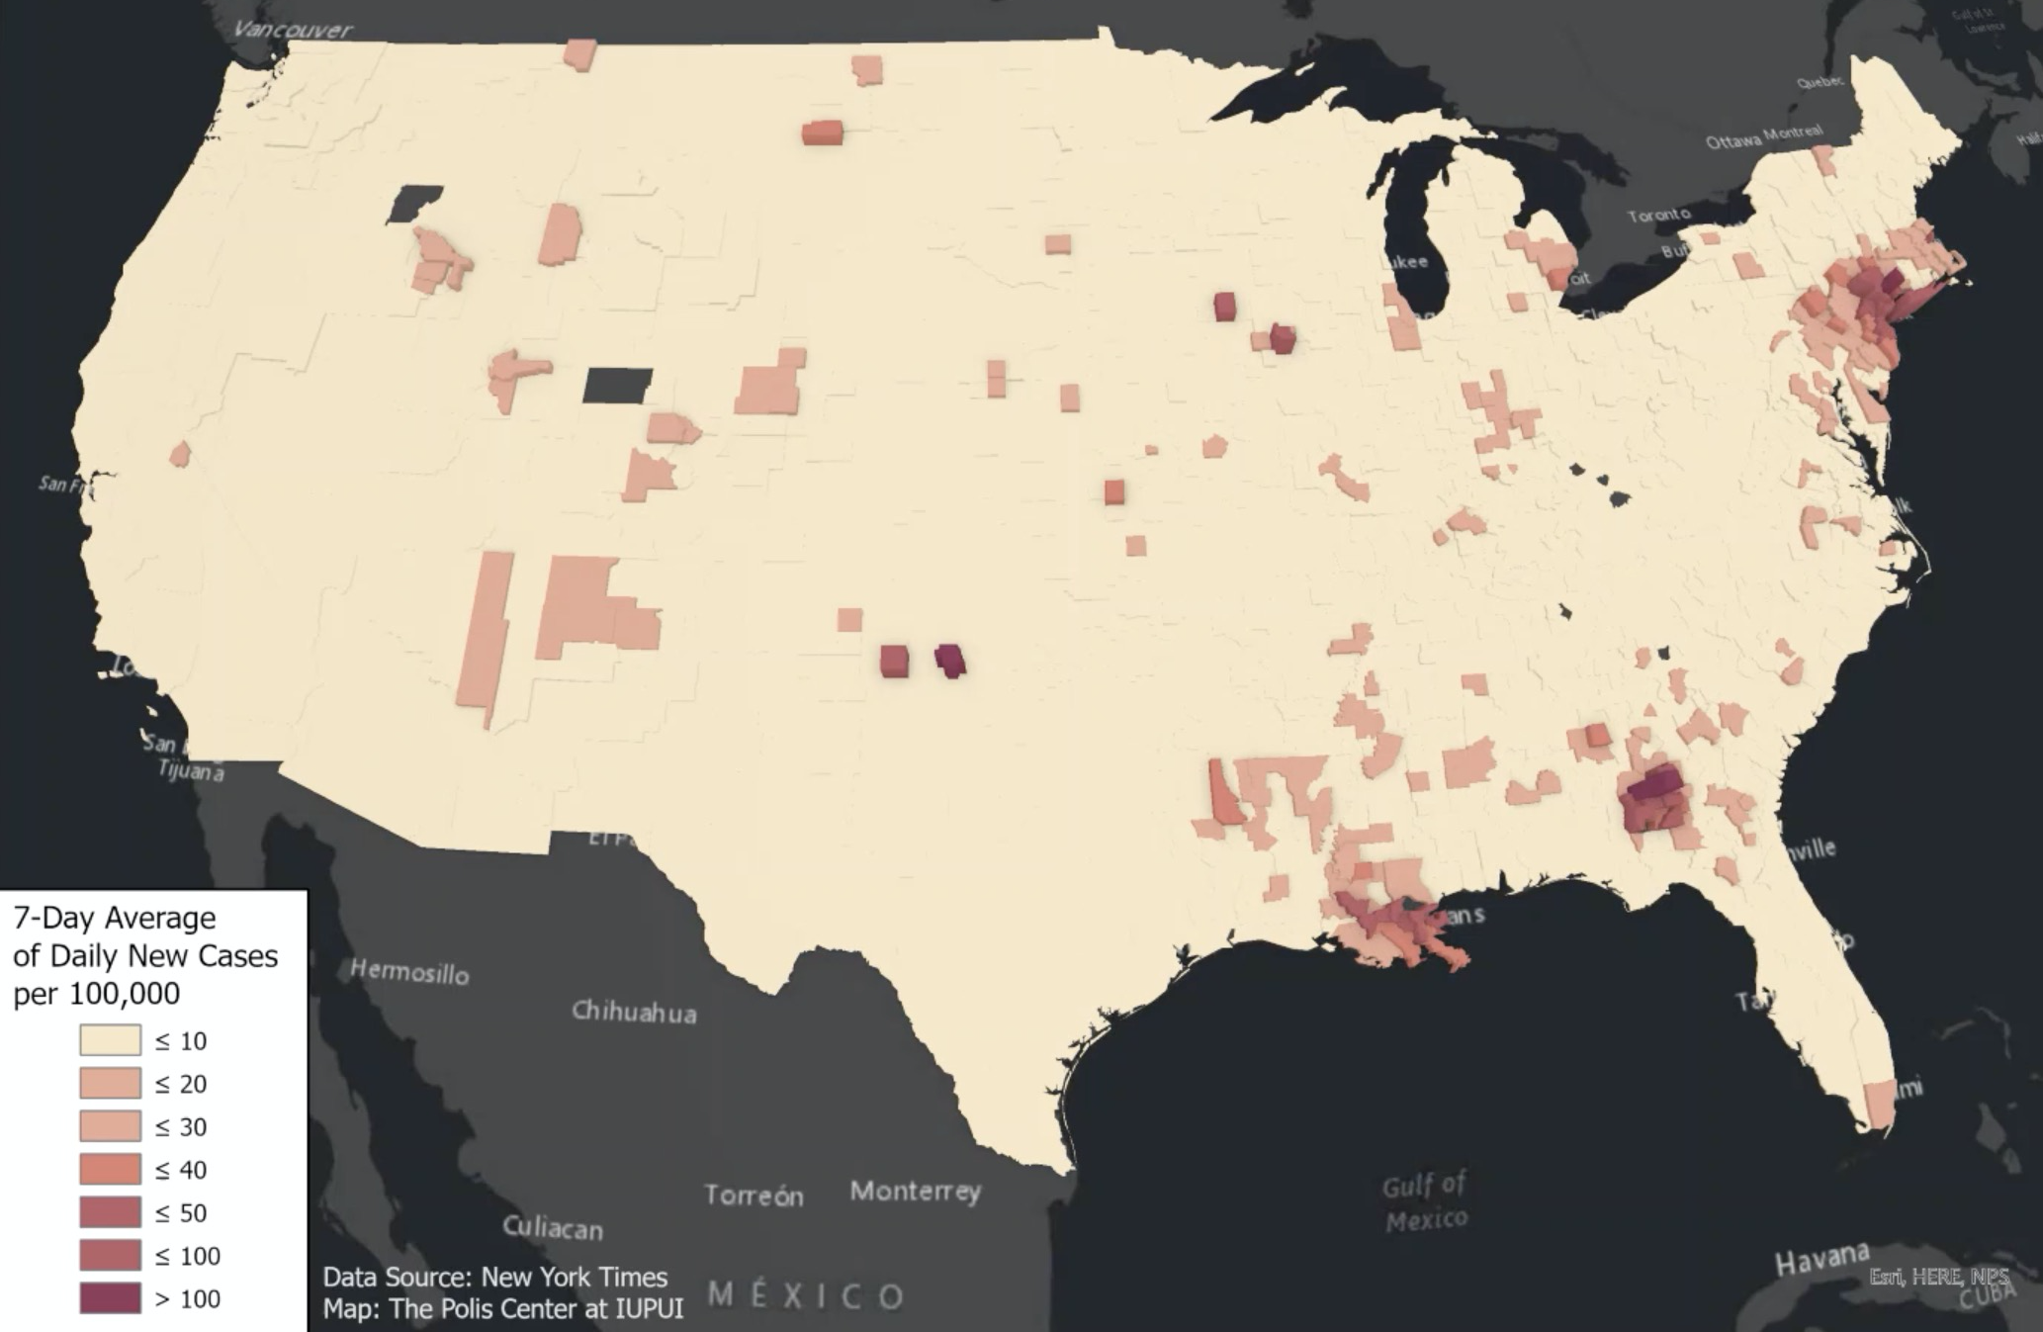
Covid incidence (7-d average) 4/10/20
https://www.savi.org/2020/10/09/animated-map-of-new-u-s-covid-19-cases-over-time/

Slide 20
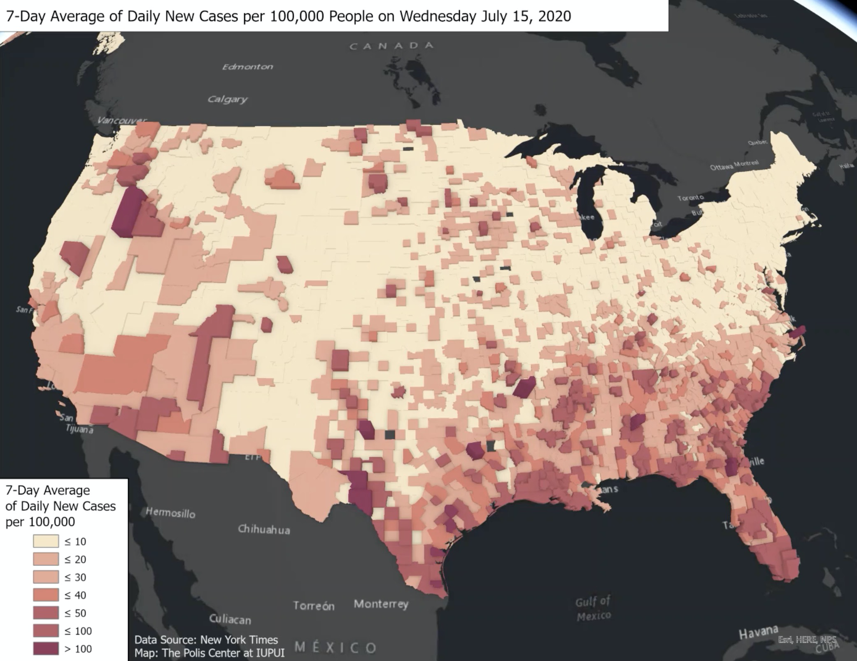
Covid incidence (7-d average) 7/15/20
https://www.savi.org/2020/10/09/animated-map-of-new-u-s-covid-19-cases-over-time/

Slide 21
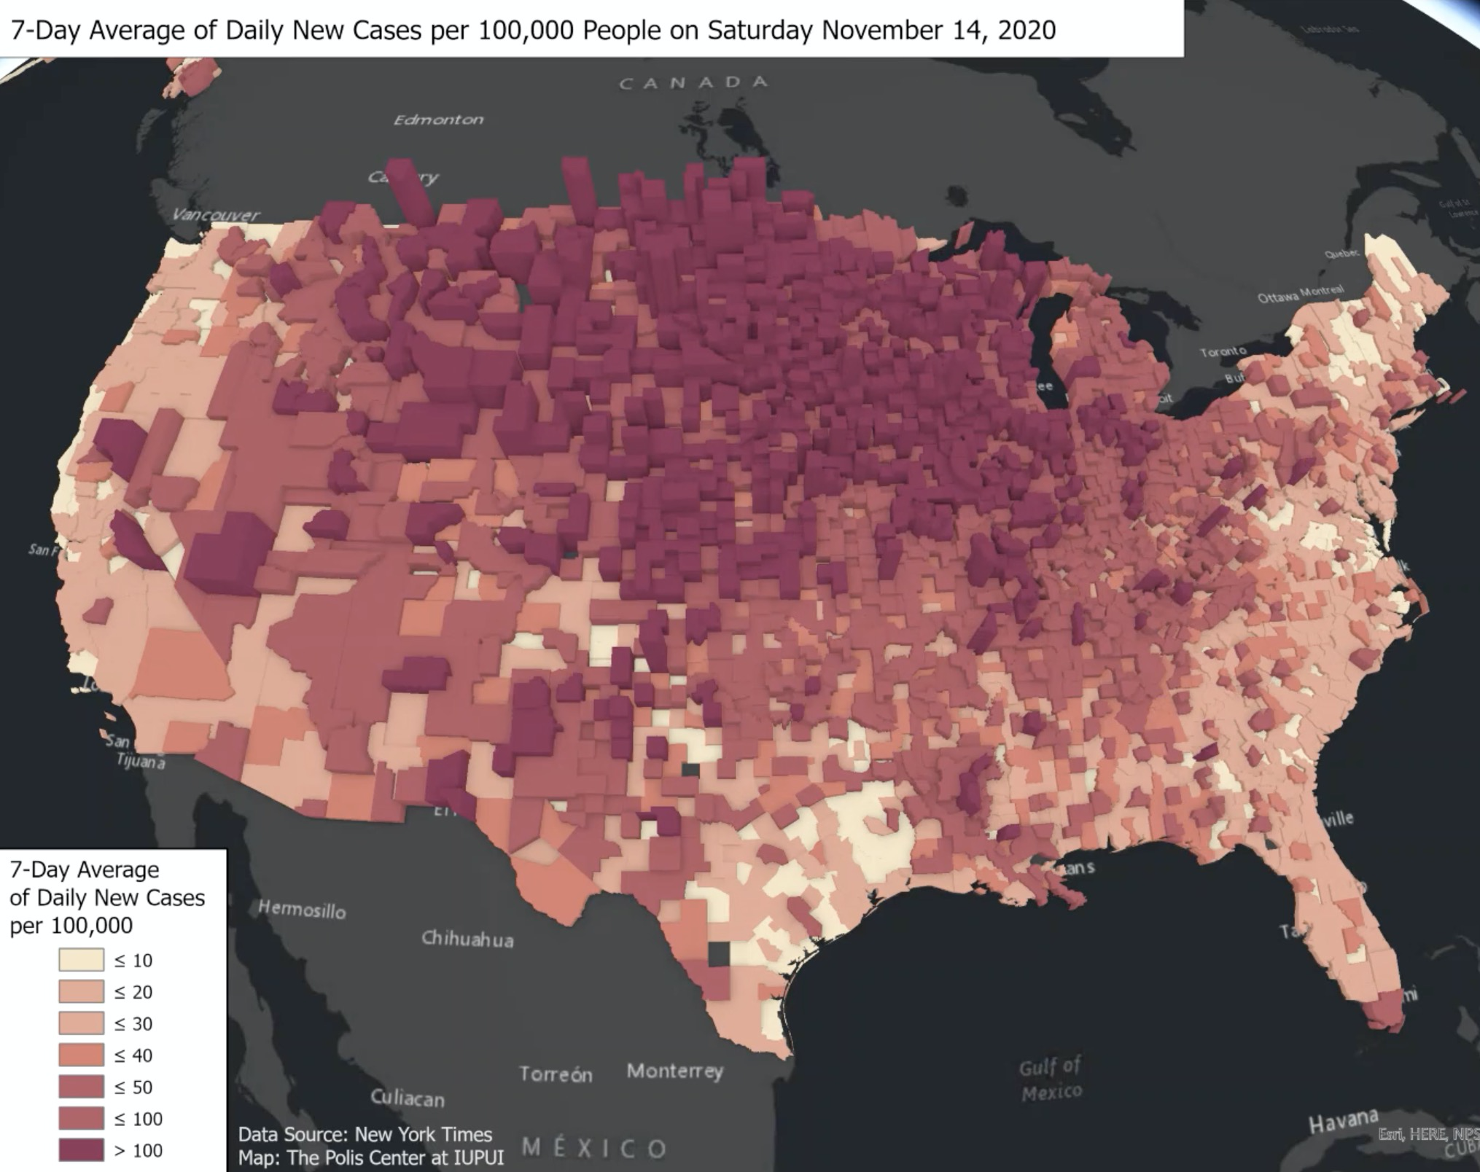
Covid incidence (7-d average) 11/14/20
https://www.savi.org/2020/10/09/animated-map-of-new-u-s-covid-19-cases-over-time/

Slide 22
Analysis of spatial health data
GIS data type |  |  |  | Health data example |  | Example analysis method
 | Points |  |  | Locations of cases and controls |  | Assess for spatial heterogeneity in disease risk and identify hotspots (e.g., spatial GAM model)¹
 | Lines |  |  | Linear sources of exposure (e.g., freeways) |  | Assess association between outcome and proximity to exposure²
 | Polygons |  |  | Regional count or rate data (e.g., incidence rate by county) |  | Assess for global clustering (e.g., Moran’s I) or local clustering (e.g., LISA) of cases
 | Raster |  |  | Raster of health-related exposures (e.g., pollution, green space) |  | Assess association between incidence rate for a location and exposure at that location³
1. Xie et al. (2017). AMIA Summits on Translational Science Proceedings; 2. Li et al. (2011). Environmental Health; 3. Chen et al. (2021). Lancet Planetary Health

Slide 23


Slide 24
Spatial hypothesis testing
As a reminder, the goal of spatial statistics is to assess for significant spatial patterns or trends
There are two broad categories of tests:
Tests of GLOBAL trends: looks for evidence of spatial heterogeneity across the entire study area
Tests of LOCAL trends: able to assess specific clusters

Slide 25
Assessing global trends
H₀: constant risk hypothesis – i.e., disease risk is constant throughout space
Disease counts are the same for regions with the same total population at risk
Incidence rates are the same if regions differ by total population at risk
Moran’s I statistic is a measure of global spatial autocorrelation
If p-value is significant (e.g., p < 0.05): evidence of spatial heterogeneity
If p-value is not significant: fail to reject null hypothesis

Slide 26
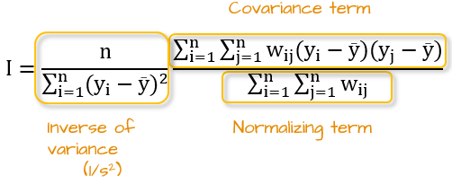
Moran’s I
Moran’s I is essentially a WEIGHTED COVARIANCE FUNCTION
- It is LARGE when y_{i} and y_{j} are large at the same time!
https://gis.stackexchange.com/questions/421403/using-weight-component-in-moran-i-calculation

Slide 27
How do we pick our weights?
We are interested in seeing if polygons close to each other have very similar values
General idea is to give weight to polygons that are close together
But how do we define “close together”?

Slide 28
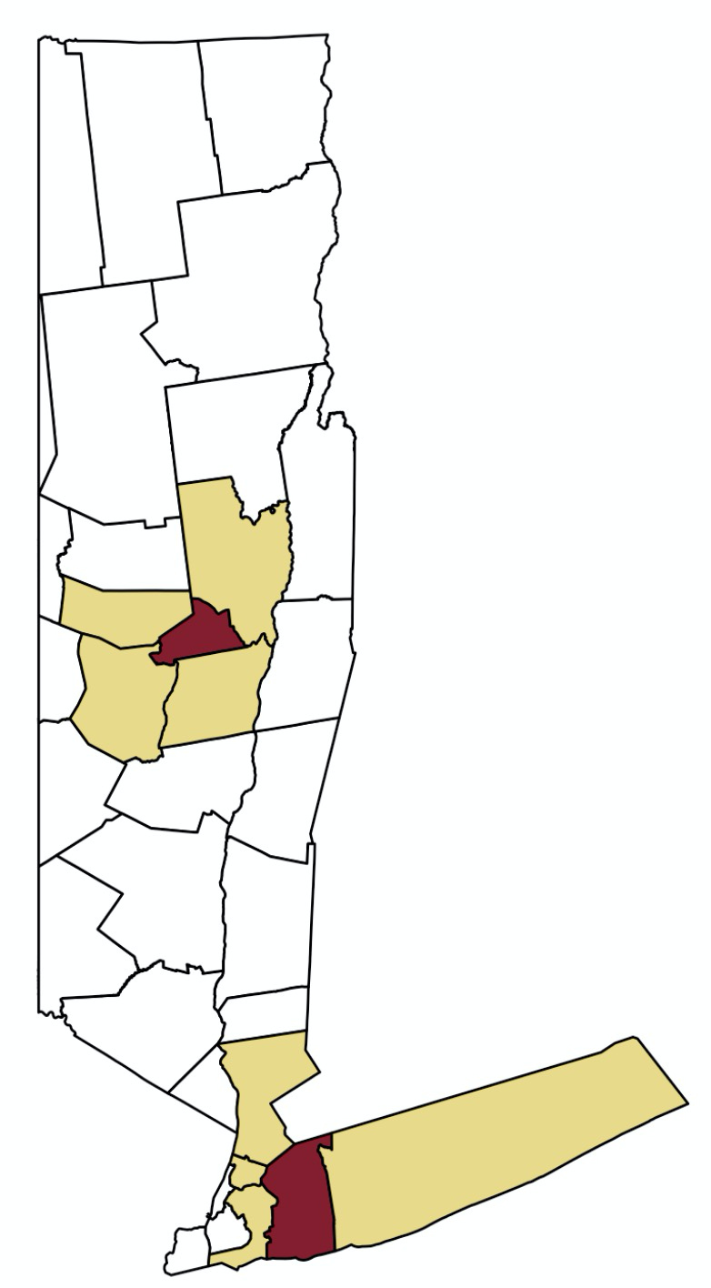
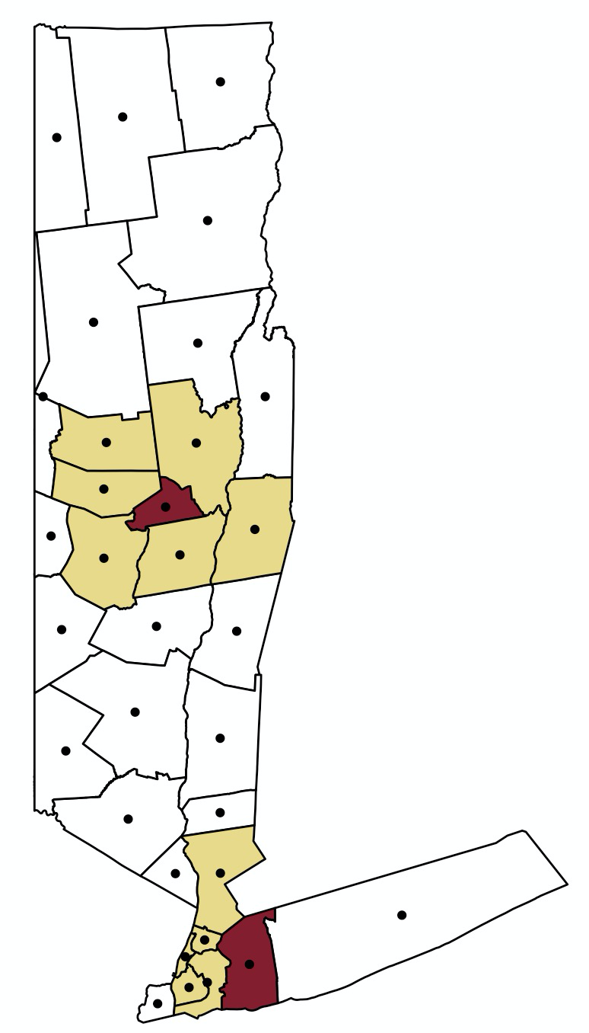
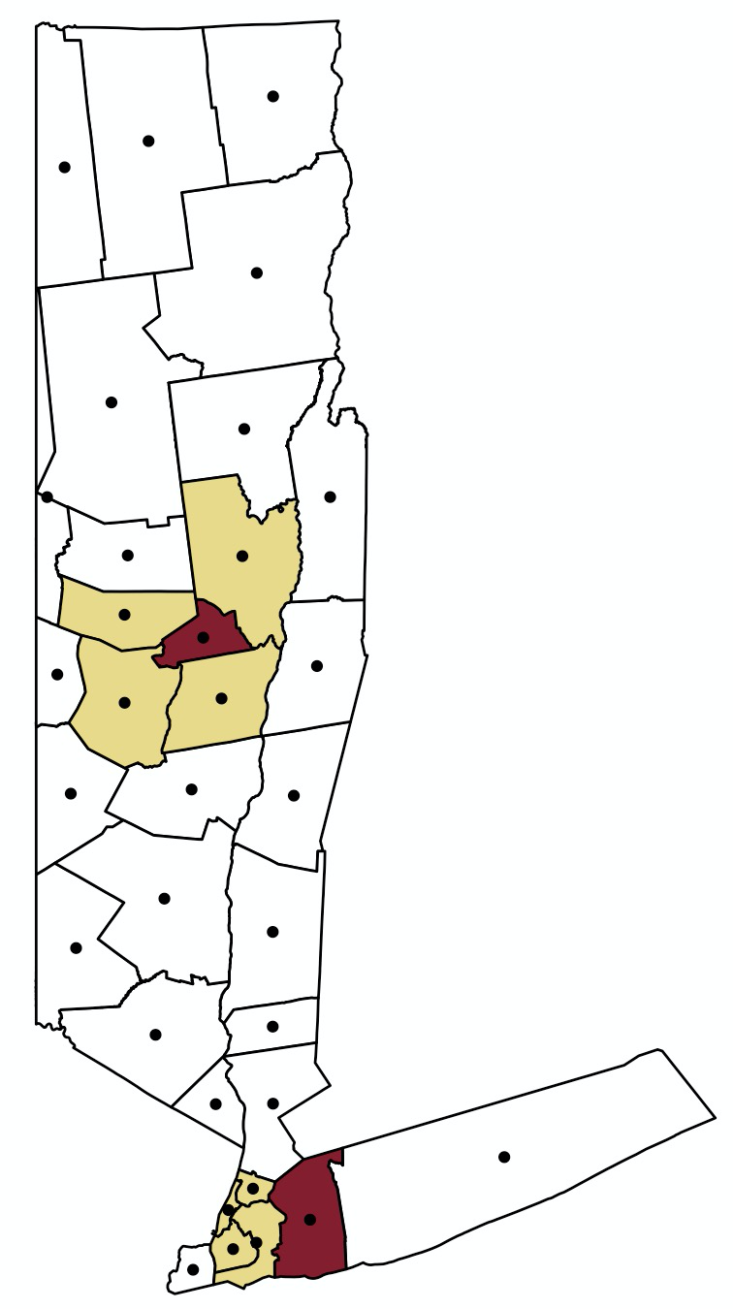
Different neighbor definitions
Index polygon
& neighbors
d = 50km
k = 4
k NEAREST NEIGHBORS
CONTIGUITY-BASED
DISTANCE-BASED
Notes:
The black points in the second and third map represent polygon (county) centroids.

Slide 29
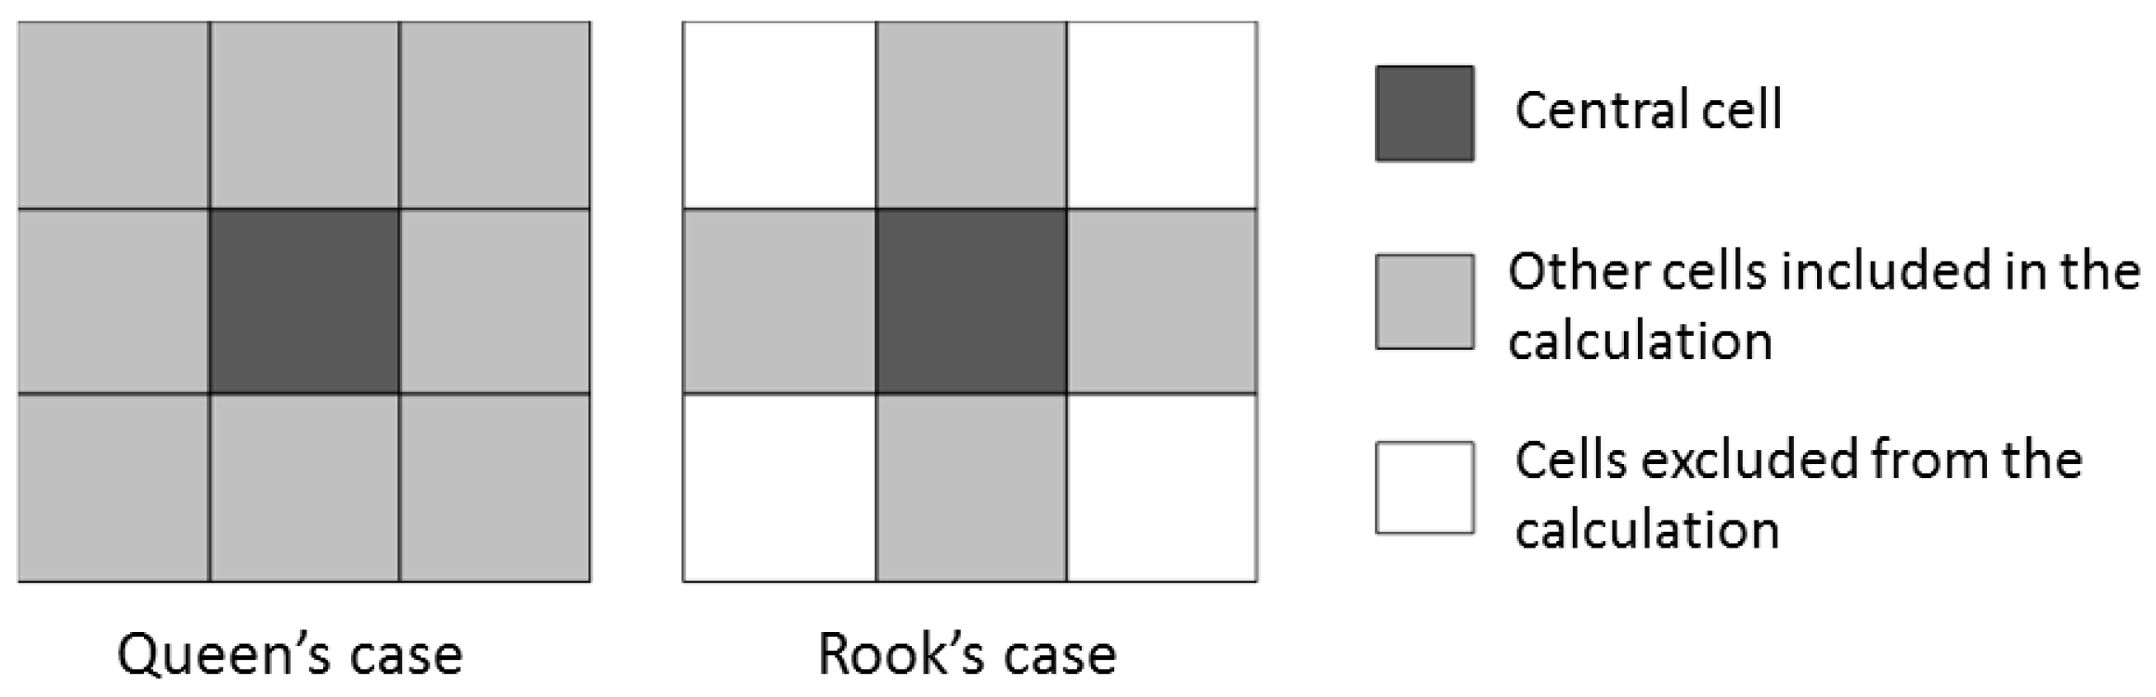
Queen’s vs rook’s case contiguity
At least one shared border or vertex
At least one shared border
Taha et al. Water 2019 (https://www.mdpi.com/2073-4441/11/2/355/htm)

Slide 30


Slide 31
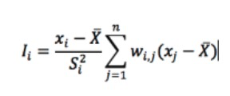
Assessing local trends
A local indicator of spatial association (LISA) provides a statistic for each location with an assessment of significance
It allows for the identification of specific disease clusters
Local Moran’s I is an extension of the Moran’s I that is defined for each region i

Slide 32
Local Moran’s I
Local Moran’s I statistic and measure of significance (pseudo p-value) is calculated for each location (polygon)
A polygon with a HIGH local Moran’s I value is one with a high disease count/rate that is surrounded by other polygons with a high count/rate
A polygon with a low value is one with a low disease count/rate that is surrounded by other polygons with a low count/rate
High-High and Low-Low clusters indicate significant disease hot spots and cold spots, respectively

Slide 33
Thank you!
Questions or comments?
xiex@upenn.edu
All the files from today will be available at:
github.com/sherriexie/SpatialAnalysisinR

